Slide 1

Being a maker – now, more fun than ever…
Gil Tal
Oct 2020

Slide 2
Being a maker, what does it mean?
A maker is an electronic biased hobbyist
You need to have basic and up SW and HW capabilities
And foremost you need passion ☺
Makers these days have huge possibilities very easy to reach
Arduino for example is a very reachable and easy to use maker’s platform
Makers today can easily build robots, drones, arcade machines and much more…

Slide 3


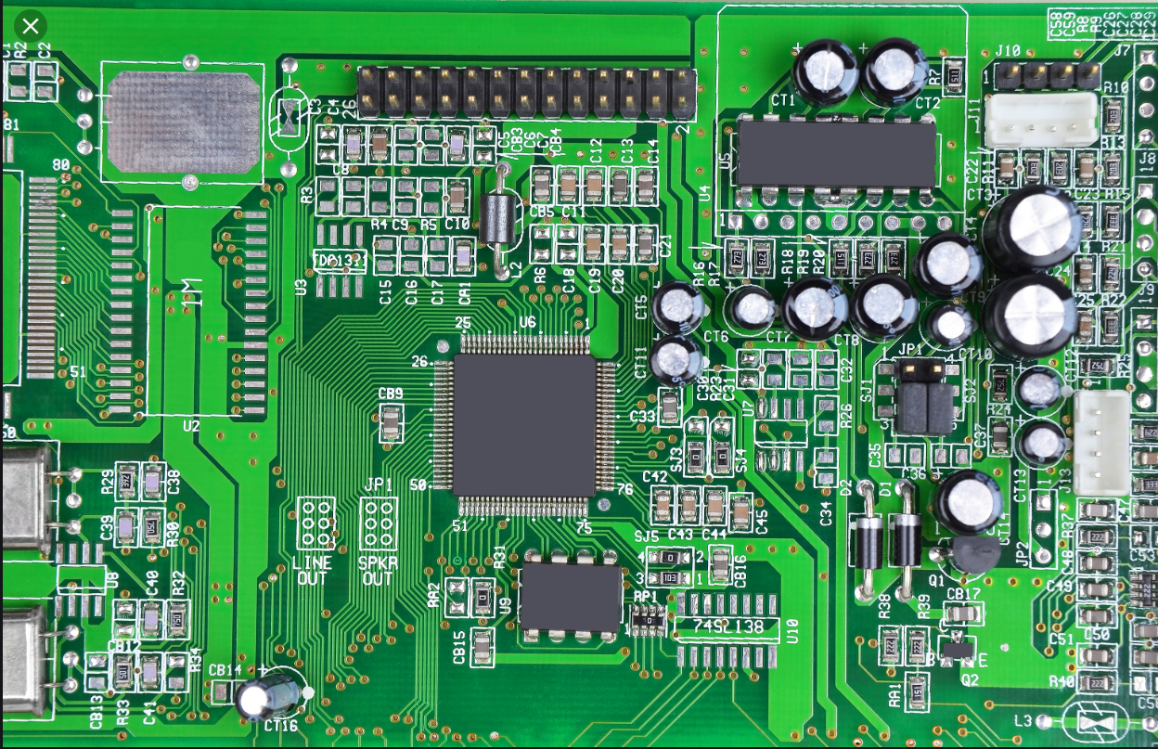
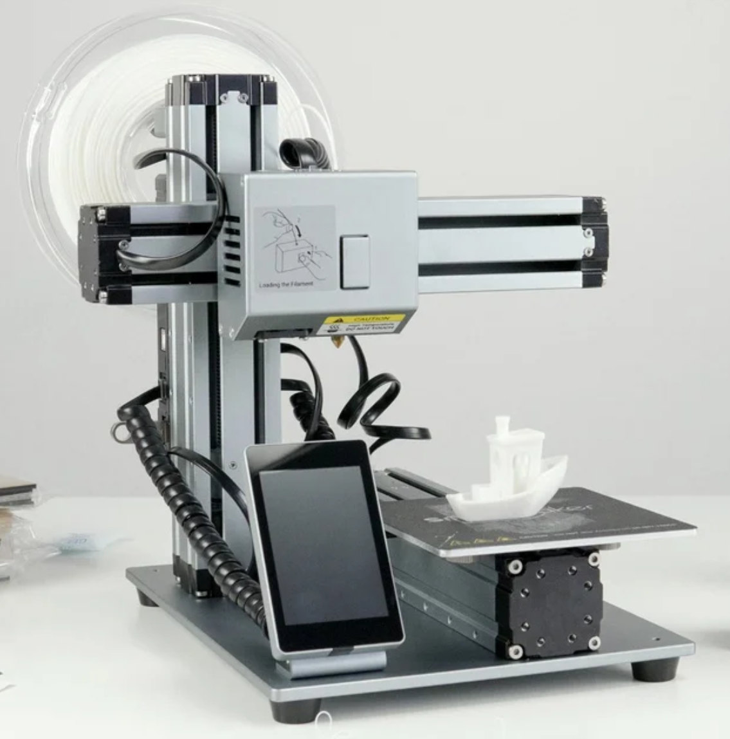
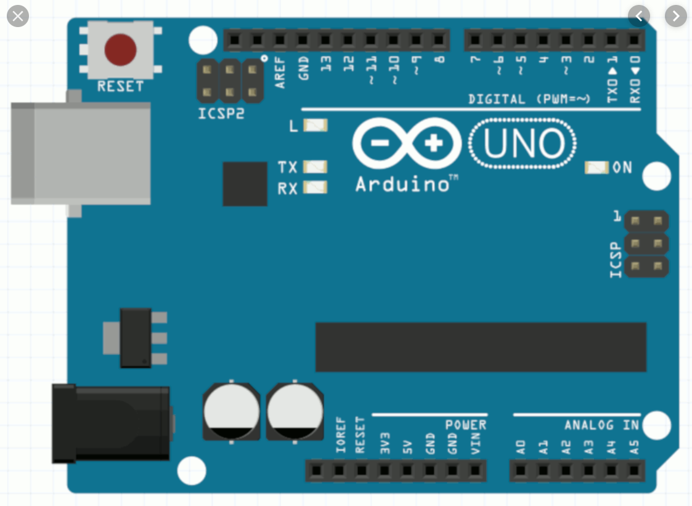
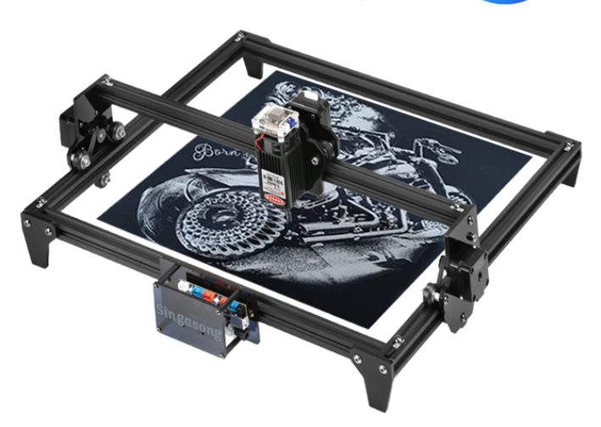
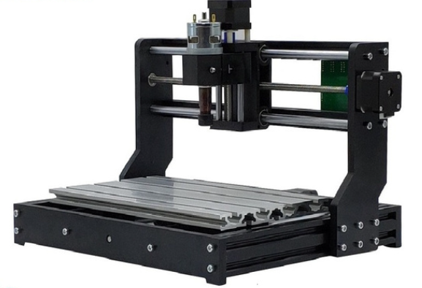
So, what have changed that makes it more fun than ever?

Slide 4
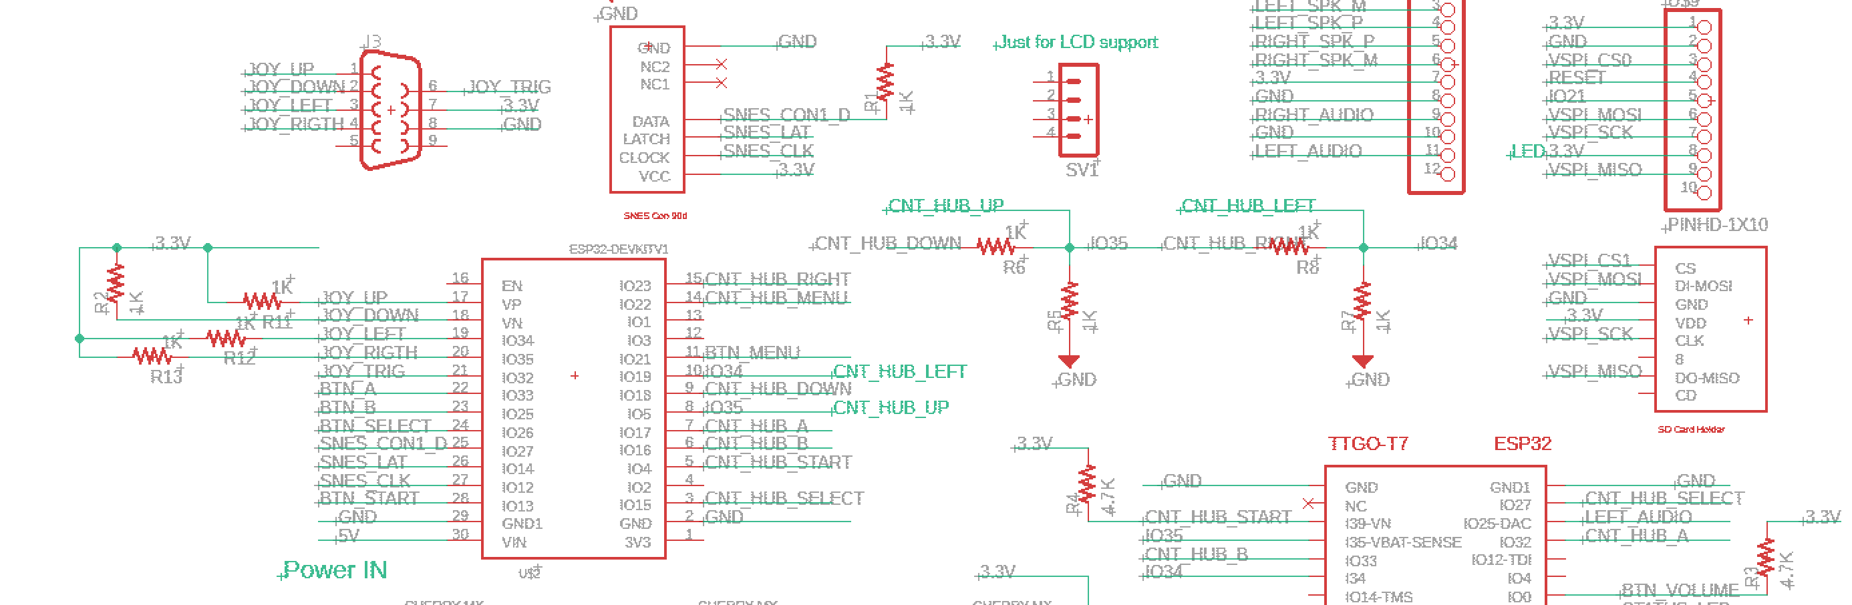
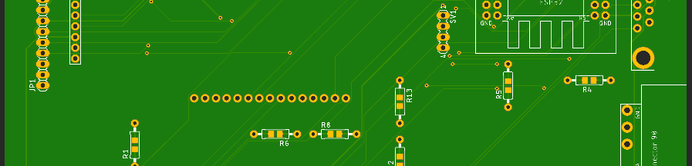
PCB production
Eagle (basic version is free) – all in one software, one click for production file
JLCpcb, PCBway – 2$ for 5 boards + shipment
~10 days to get the board

Slide 5
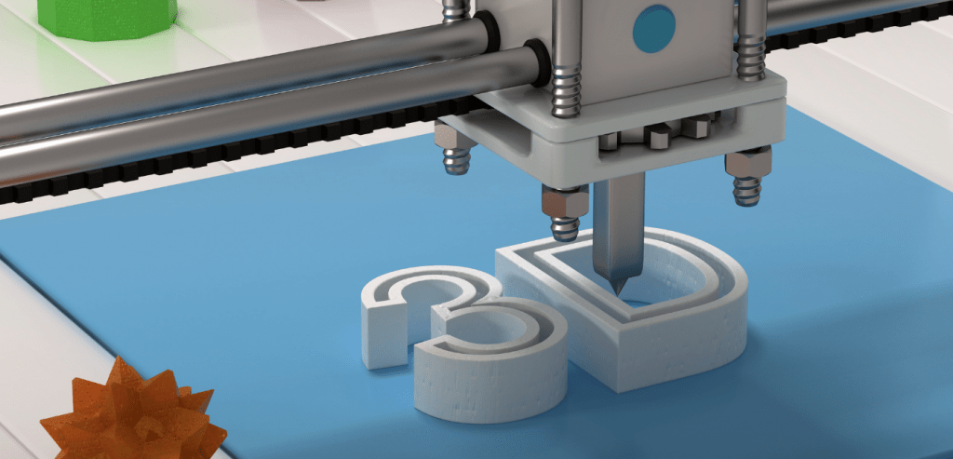
Fusion 360 is free for makers!
3D printers comes relatively cheap (~300$)
1KG of PLA\Resin is around 25-35$
There are FDM printers and resin (liquid)
Resin can print amazingly detailed objects
For FDM there are some interesting materials

Slide 6
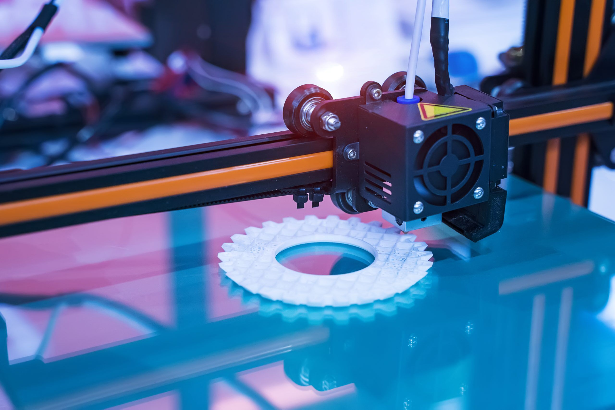
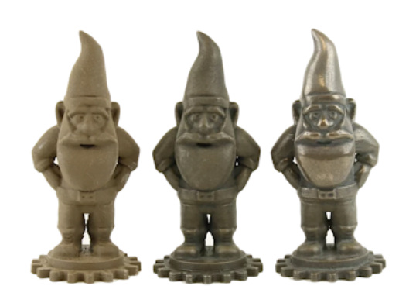
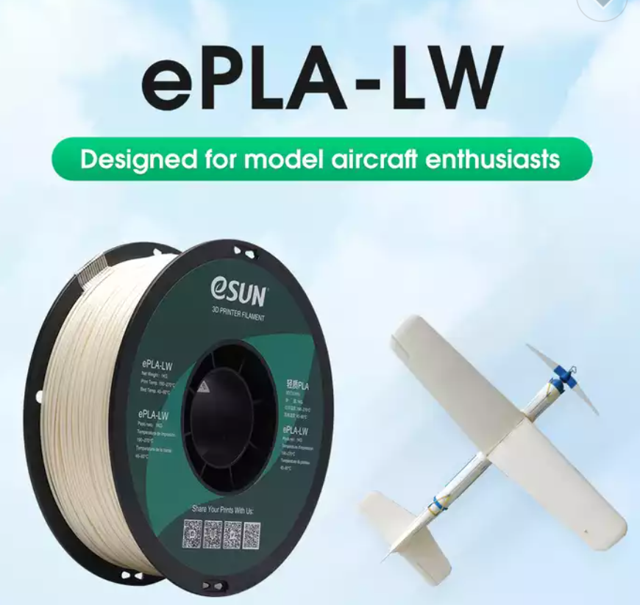
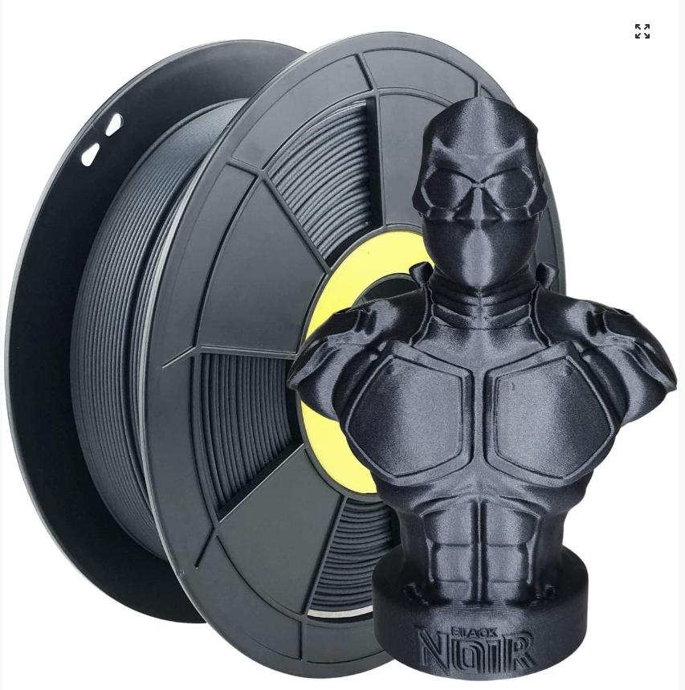
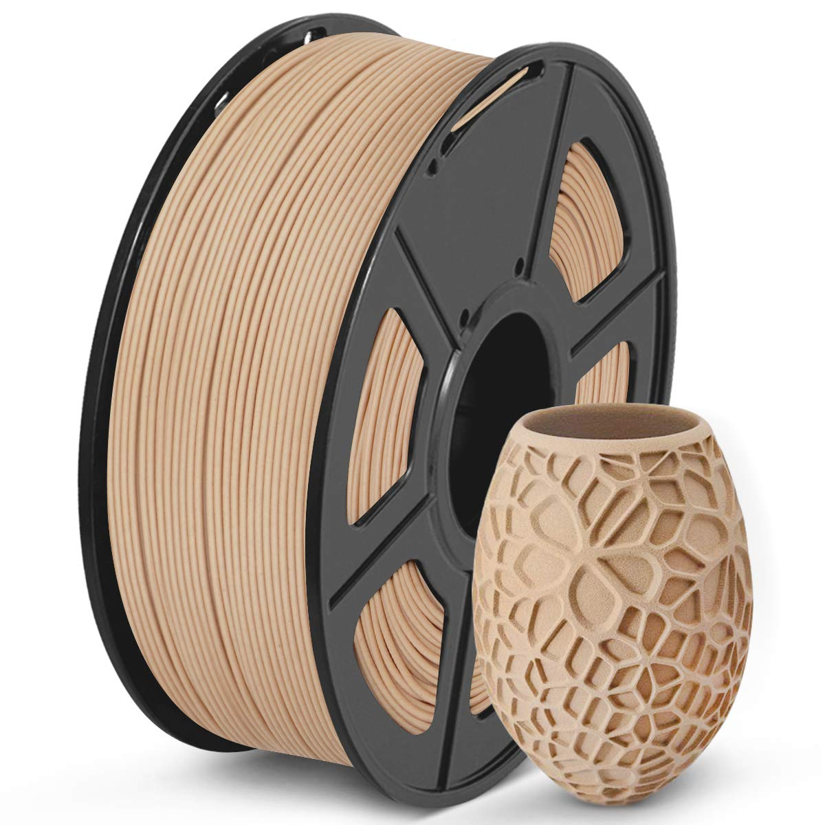

Slide 7
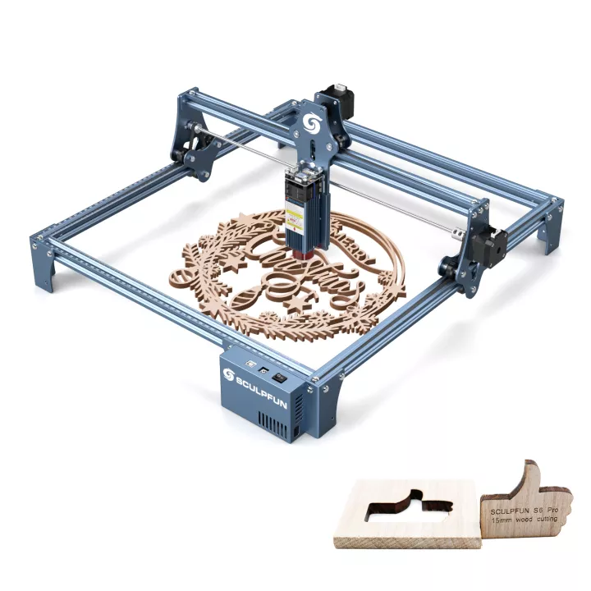
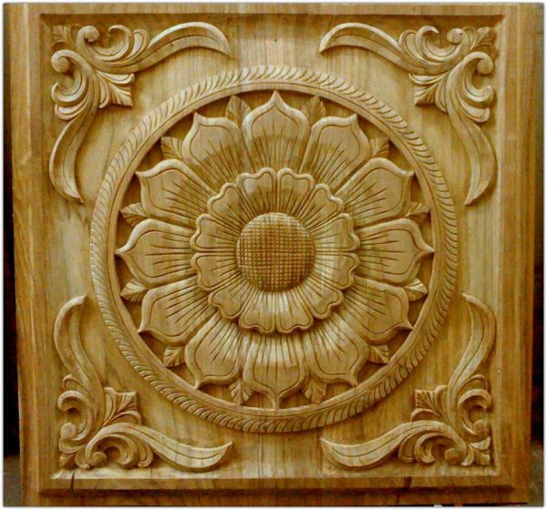
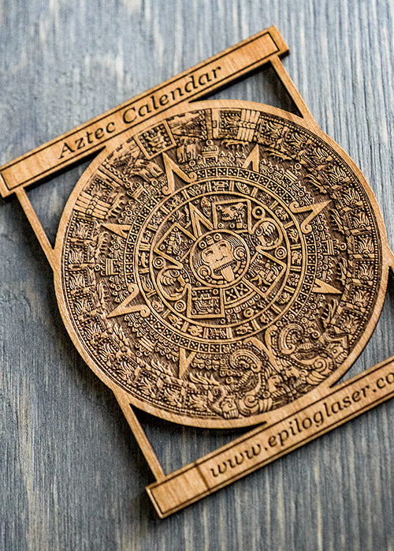
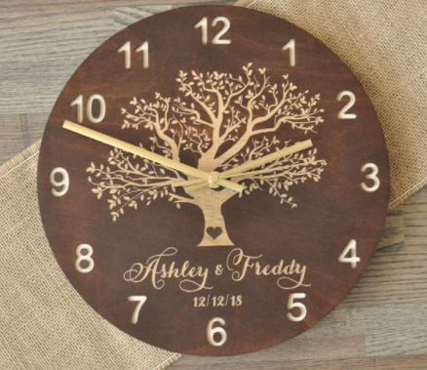
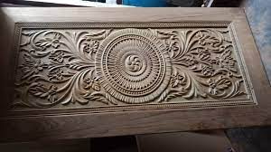
CNC and laser engraver \ cutter
Around 300$+
Amazing capabilities

Slide 8

The Arduino makers platform – how it all started…
The Arduino project was started at the Interaction Design Institute Ivrea (IDII) in Ivrea, Italy
In 2003 Hernando Barragán created the development platform Wiring as a Master's thesis project at IDII – Which was used as the basis for the Arduino platform
Under the supervision of Massimo Banzi and Casey Reas. Casey Reas is known for co-creating, with Ben Fry, the Processing development platform
The project goal was to create simple, low cost tools for creating digital projects by non-engineers!
The initial Arduino core team consisted of Massimo Banzi, David Cuartielles, Tom Igoe, Gianluca Martino, and David Mellis, but Barragán was not invited to participate
Millions of Arduino boards are in use around the world!

Slide 9
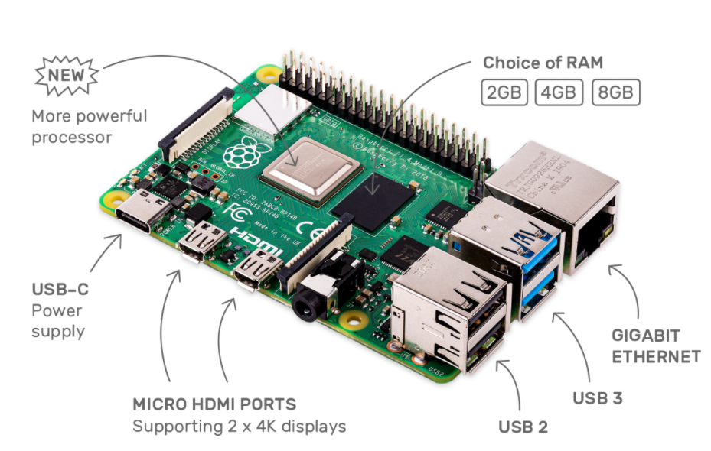
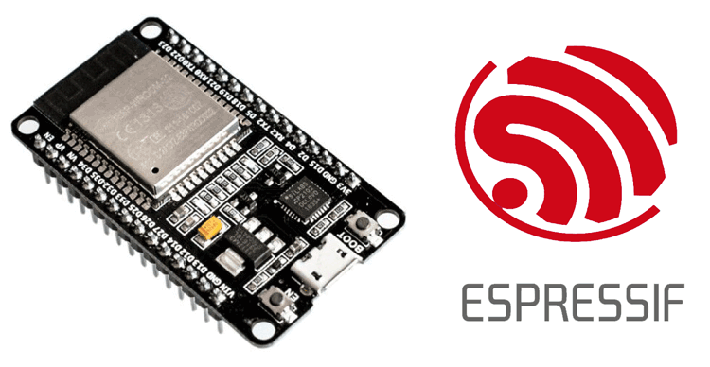
Arduino was just the beginning …
Raspberry PI 4
40-50$
Monster performance
Complex AI
ESP8266\ESP32\ESP32 S2\S3\C3\C6
4-8$
Great performance (Dual CPU @ 240MHz)
WiFi and Bluetooth
Camera\LCD
Arduino IDE!
FreeRTOS (Multi Tasking)
OTA
Complex projects
Up to 8MB of RAM!!
Arduino Uno\Due\Zero
2-5$ (clones)
Limited performance and features
Enough for lots of simple projects

Slide 10
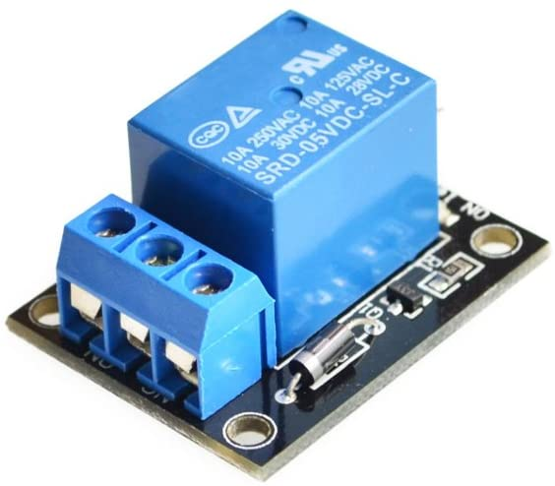
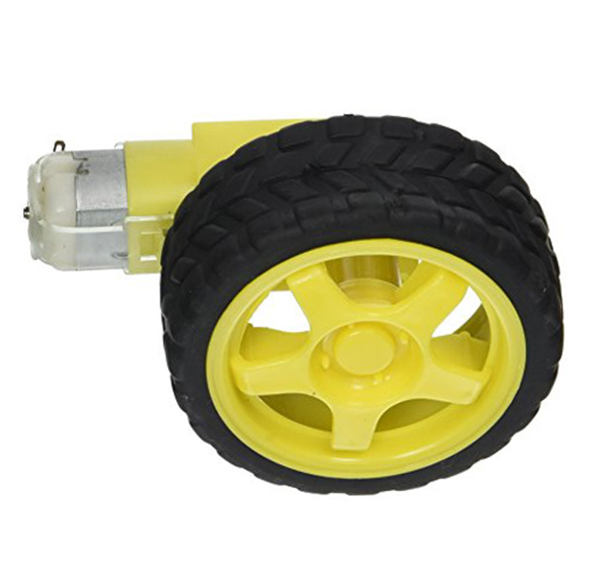
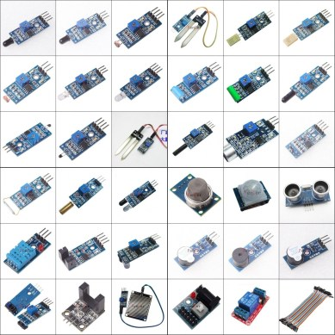
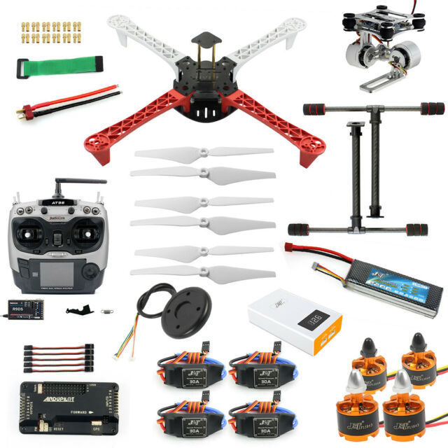
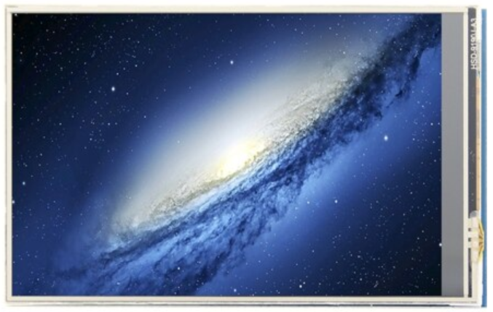
What is there for us to use:

Slide 11
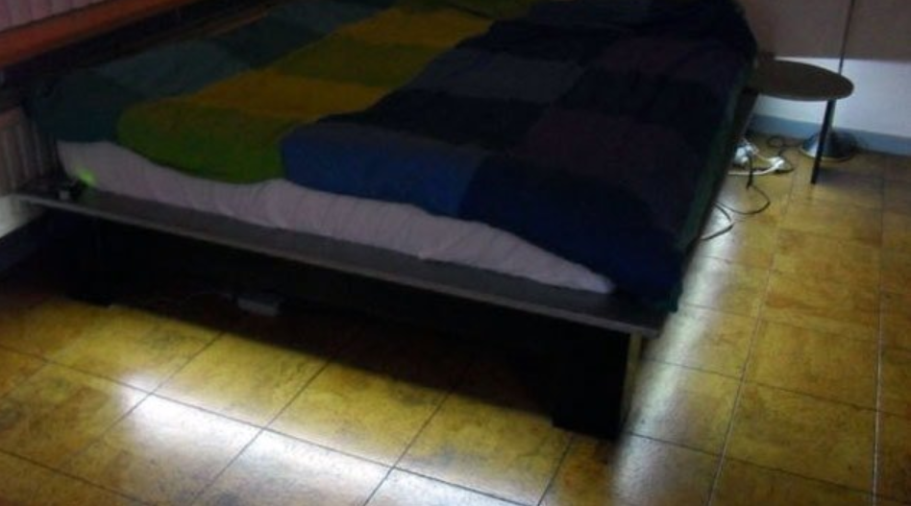
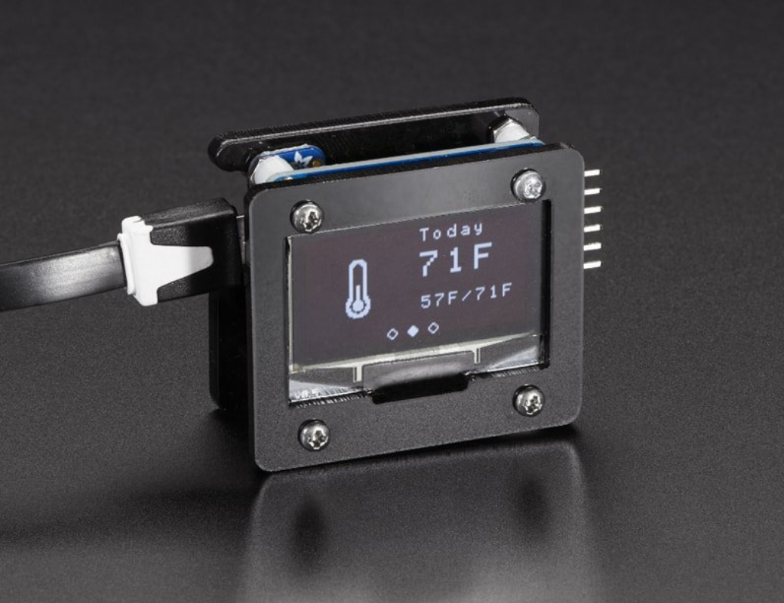
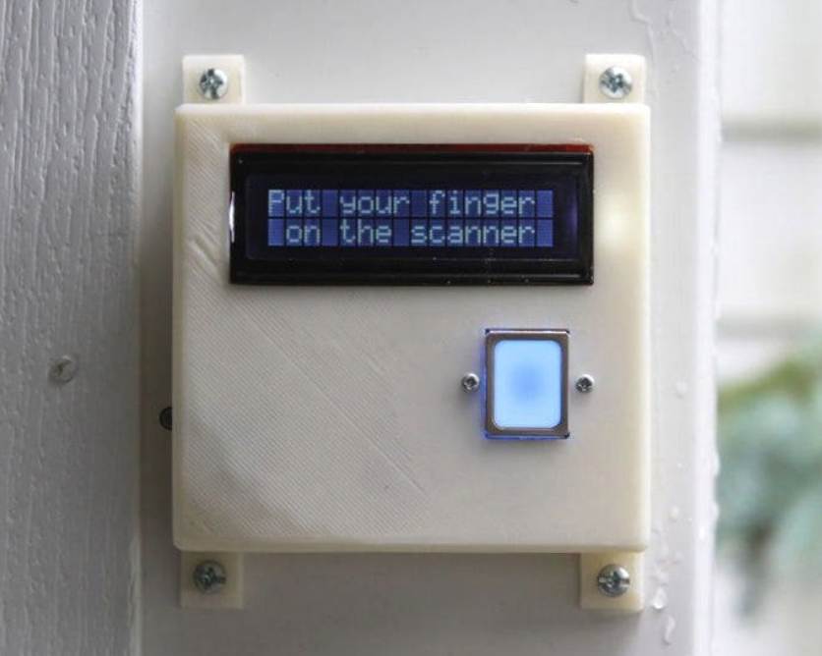
Some cool projects

Slide 12
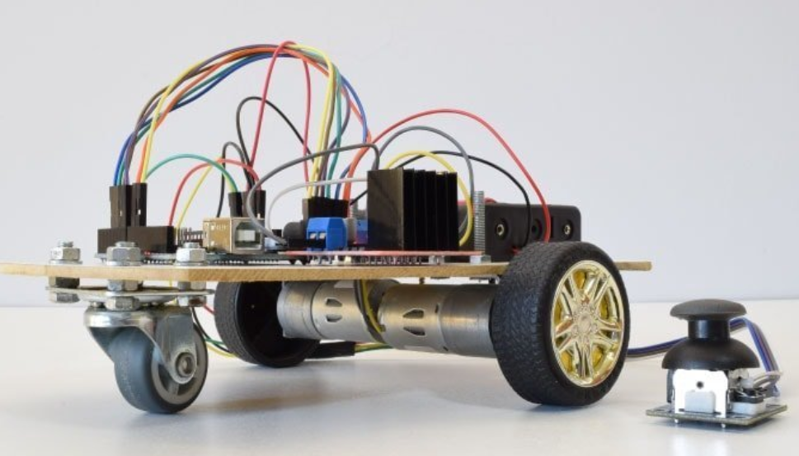
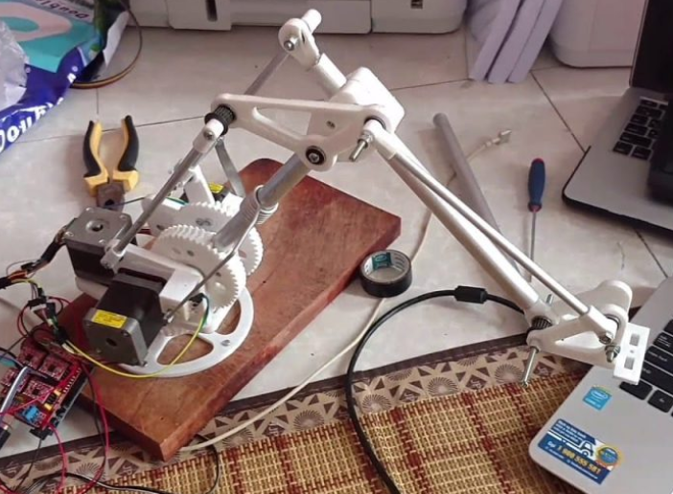
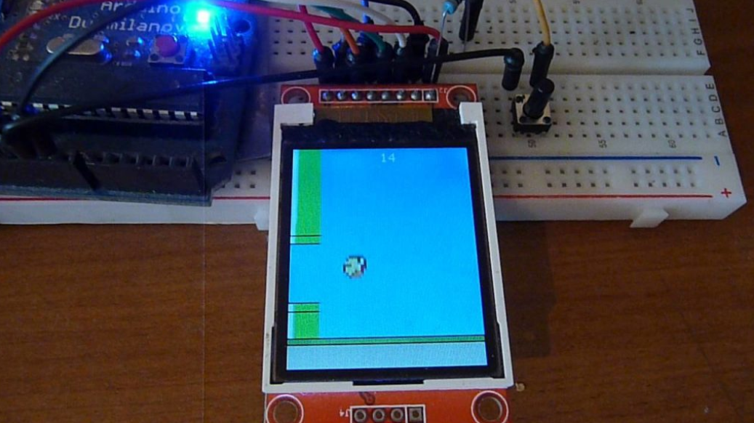
More…

Slide 13
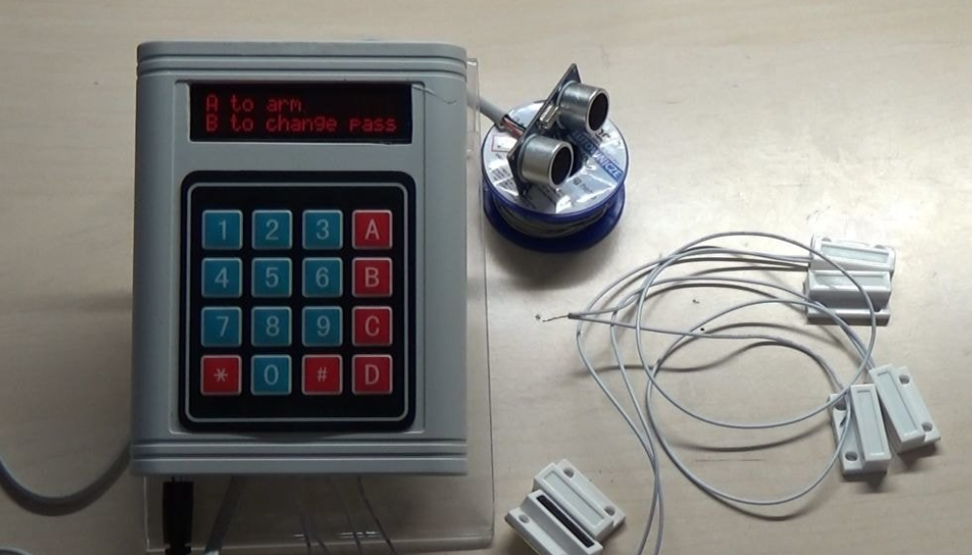
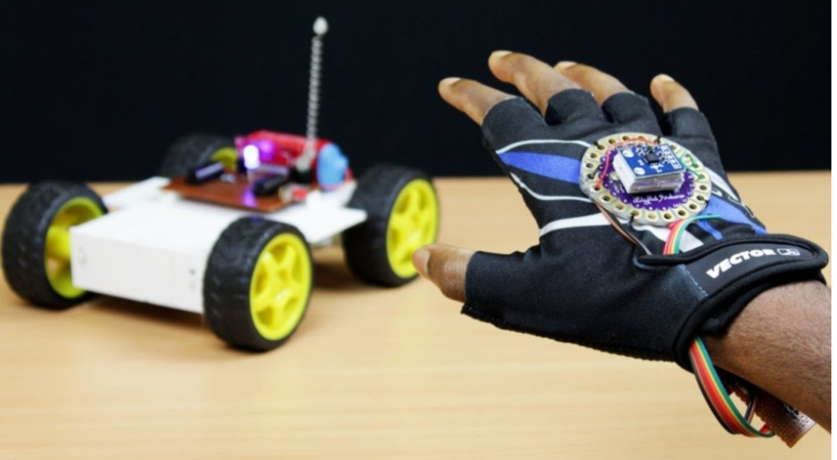
And more…

Slide 14
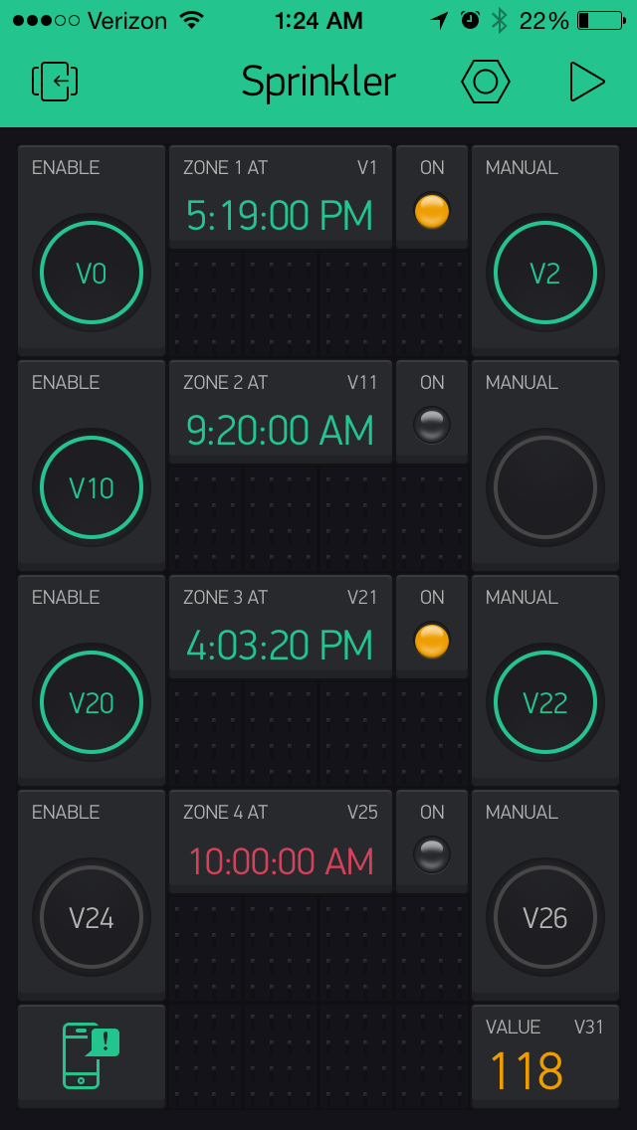
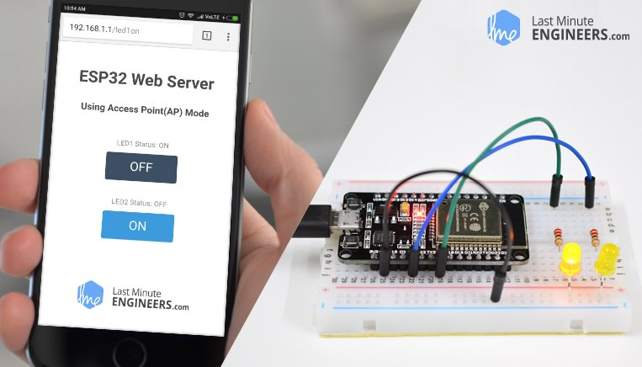
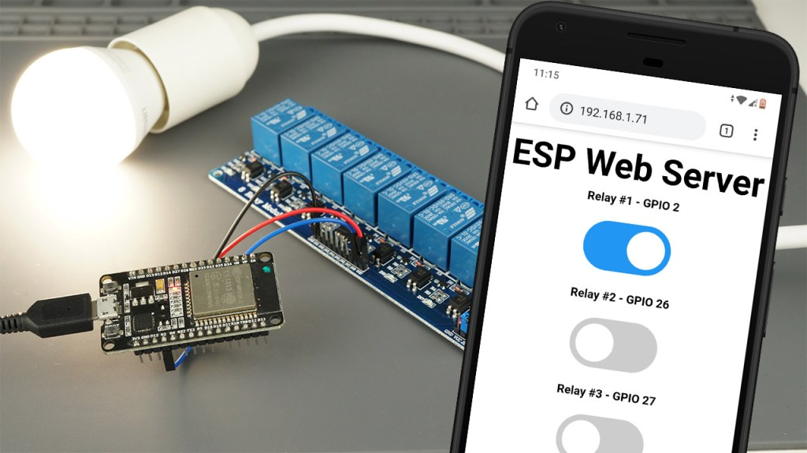
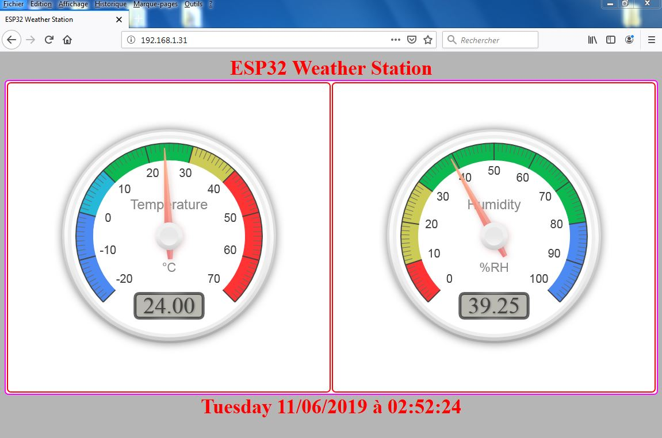
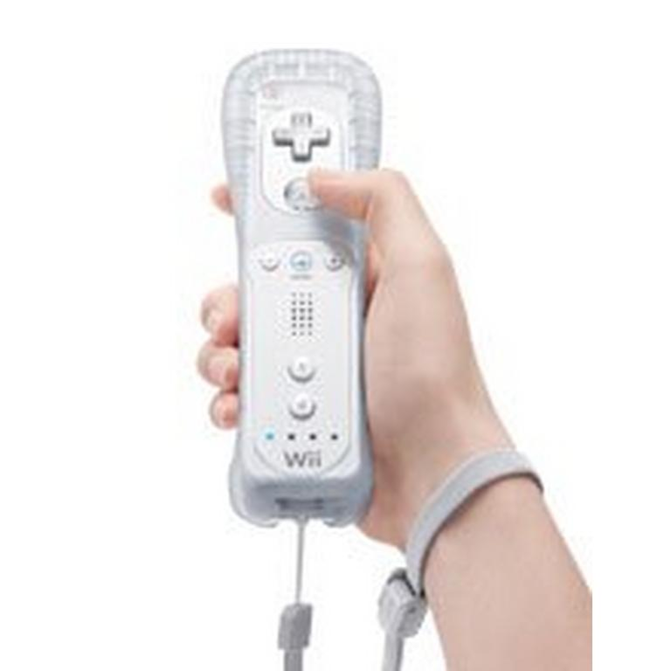
How We can control our devices …
Using our smartphone \ Tablet
Any device with a browser
WII mote (Via Bluetooth)
IR remotes
Build our own control device

Slide 15
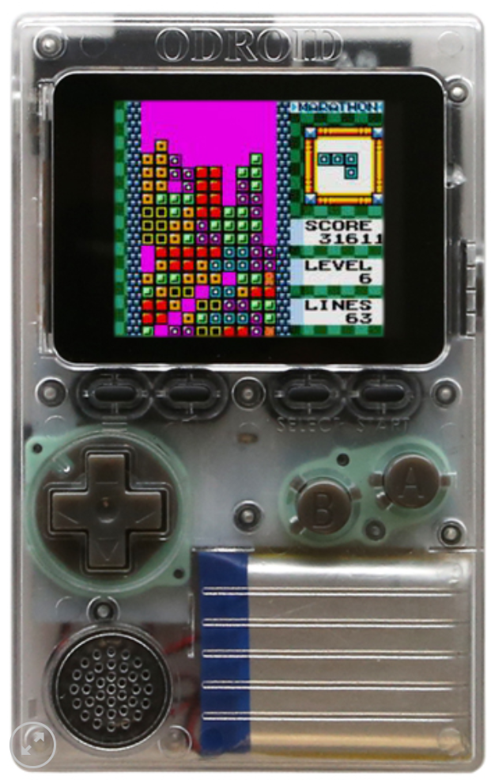
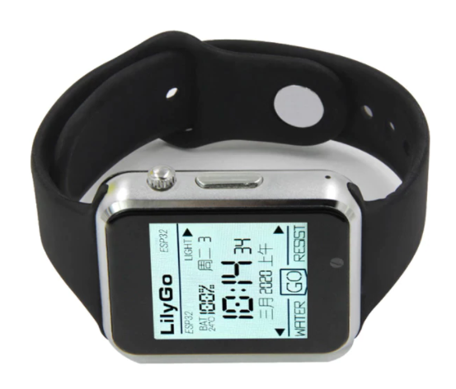
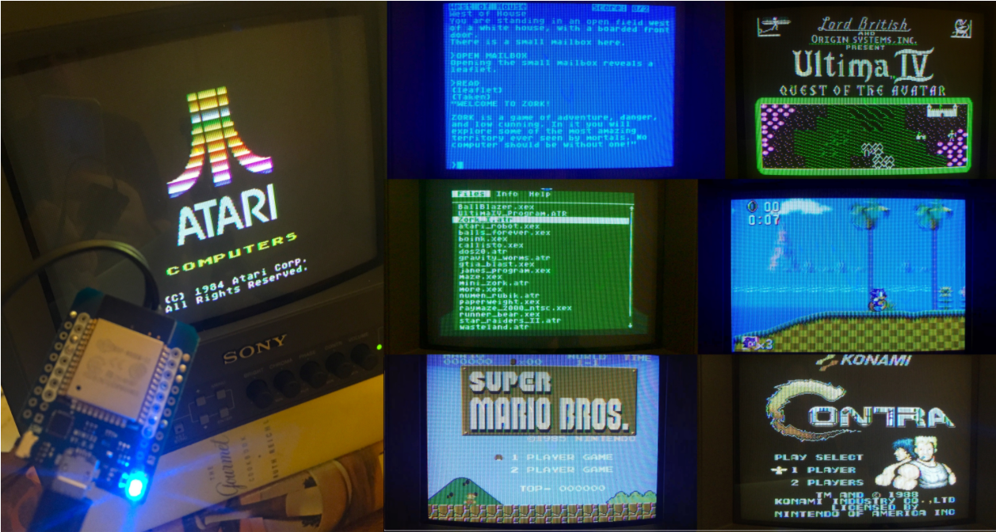
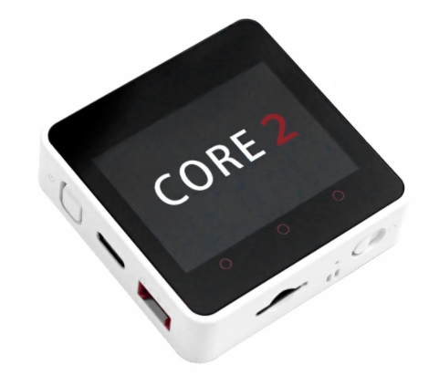
ESP32 cool projects…

Slide 16
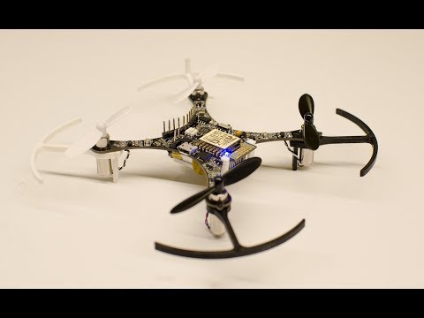
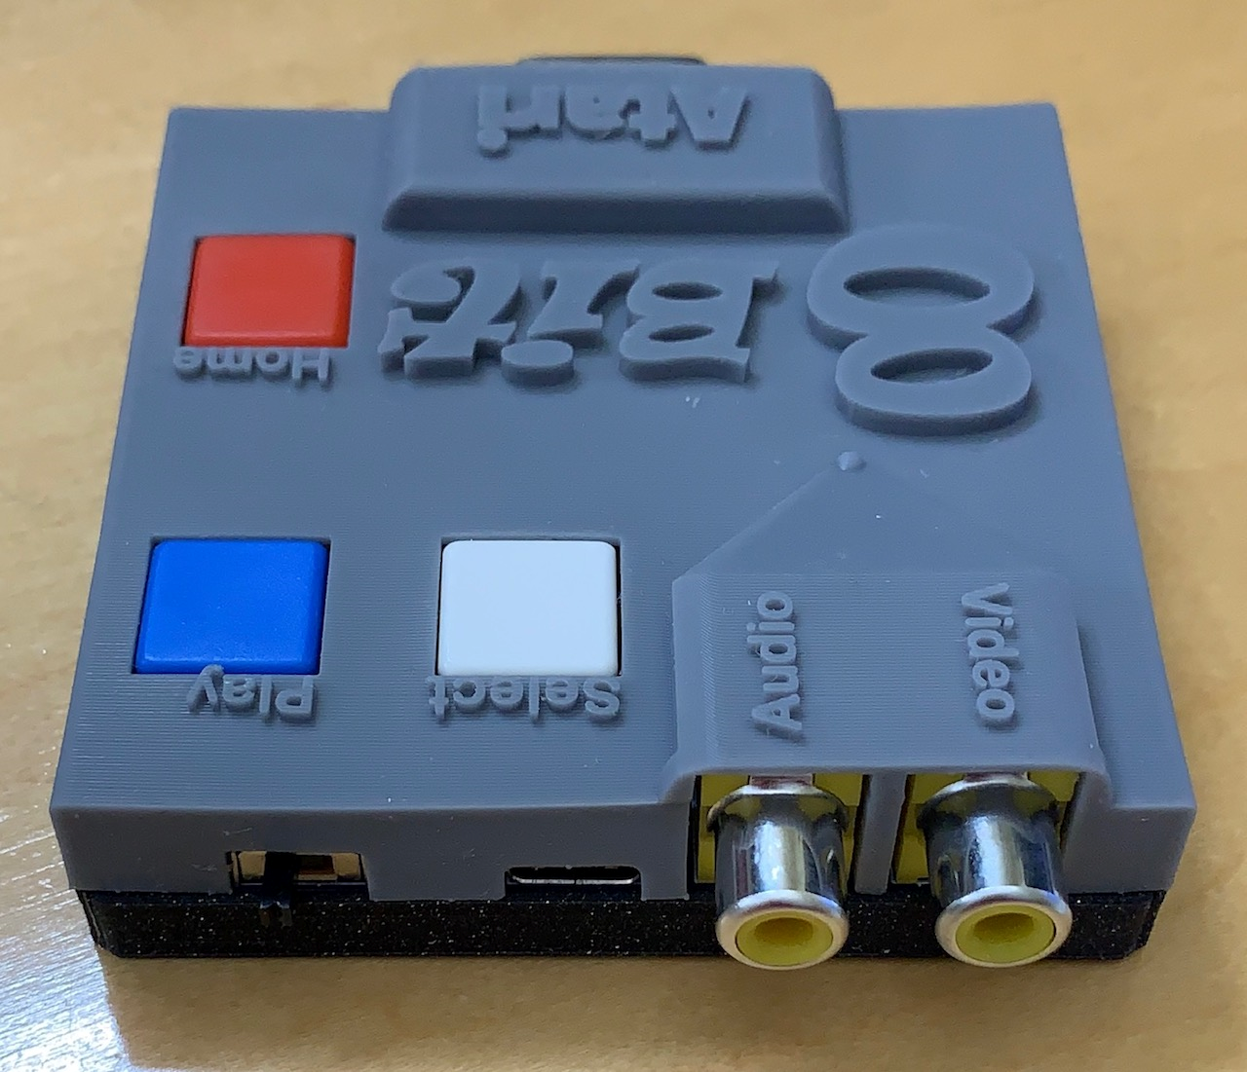
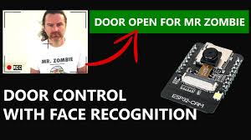
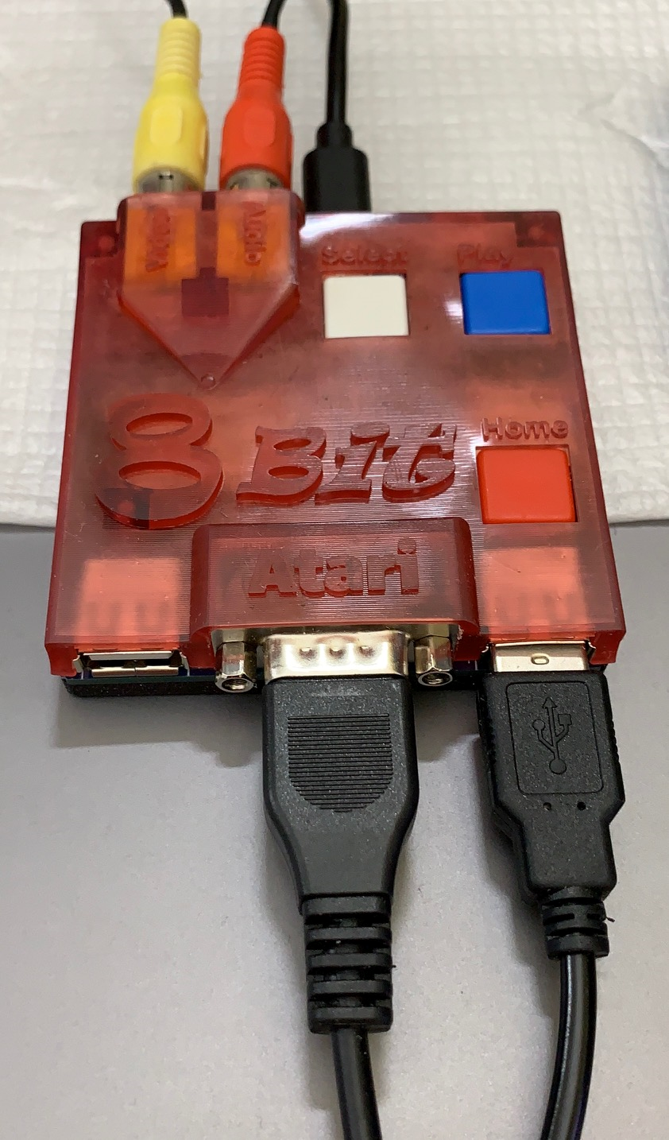
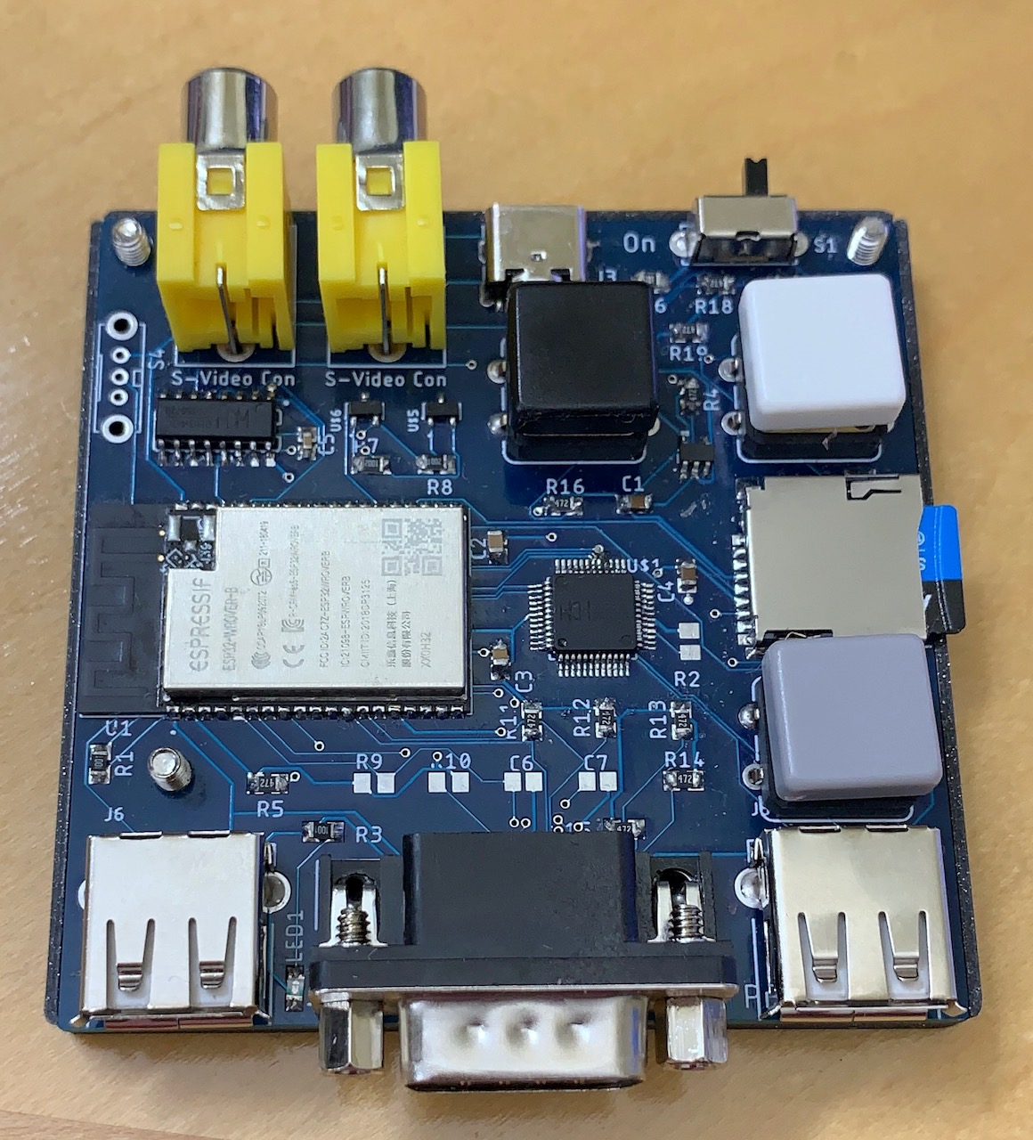
More cool esp32 projects…

Slide 17
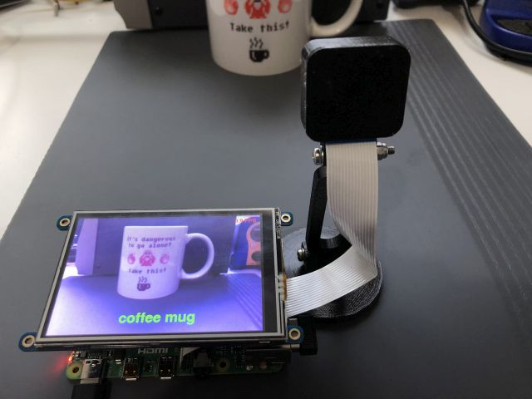

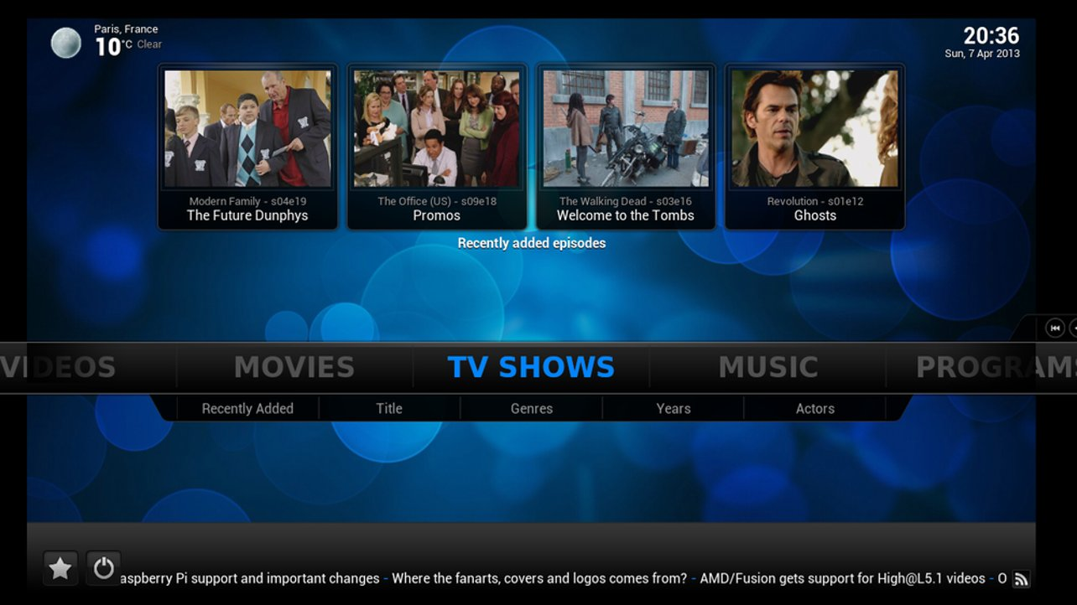
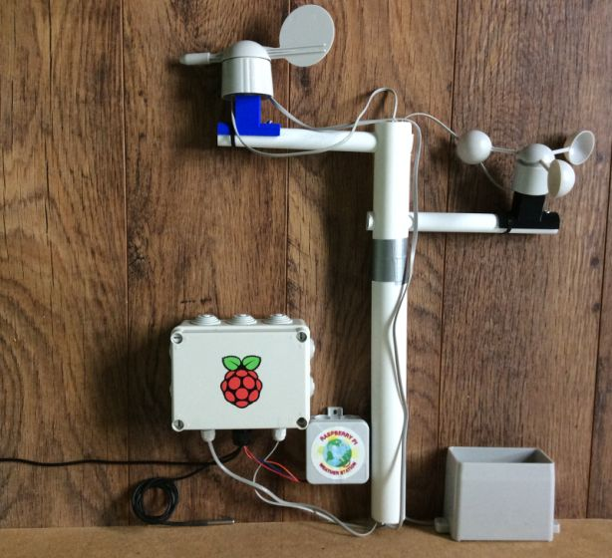
Raspberry PI 4 projects

Slide 18






More of the R-PI4…
Zoom meeting station

